Slide 1


Predicting Superstore Sales
Nicole Reiswig

Slide 2
Agenda
Introduction & background
Problem statement & hypothesis
Data analytics process
Data overview
Data visualizations
Summary of findings
Limitations of techniques & tools
Proposed action
Expected benefit

Slide 3

Introduction & background
Master of science in data analytics
Master of business administration
Bachelor of science in healthcare management
Previously an Executive Director for long-term care facilities
Currently located in the Florida panhandle
From Washington state

Slide 4
Problem statement & hypothesis
Alternate hypothesis H₁ : A predictive regression model can be constructed from the superstore sales data."
Can a multiple linear regression model be constructed based solely on the research data?
Null hypothesis H₀ : A predictive regression model cannot be constructed from the superstore sales data"
1
2
3

Slide 5
Data Analytics process
STAGE
STAGE
STAGE
STAGE
STAGE
01
02
03
04
05
Data acquisition
Data cleaning
Data wrangling​
Exploratory data analysis
Predictive modeling
Cleaning:
Missing, null, duplicates
Wrangling:
One-hot encoding
Converting data type
EDA:
Visualizations
Qqplot, Shapiro-wilk
Correlation matrix
VIF
Predictive modeling:
Multiple linear regression

Slide 6

Data overview
Consisted of 9800 rows of superstore sales data
18 columns including sales data, product categories, geographic regions and customer segment
Predictive modeling using multiple linear regression

Slide 7
Project analysis slide 5
Exploratory Data Analysis

Slide 8
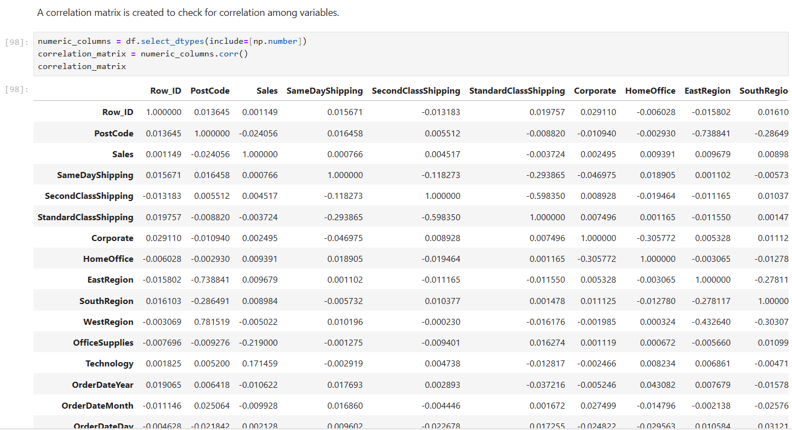
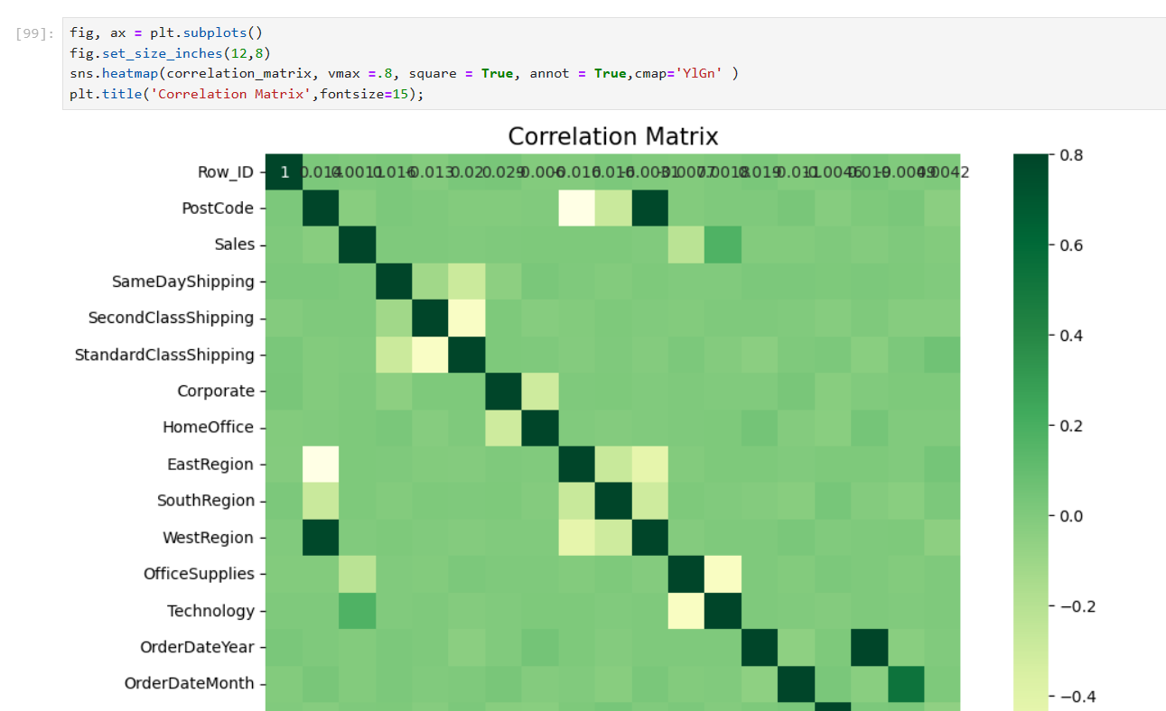
Project analysis slide 5
Correlation

Slide 9
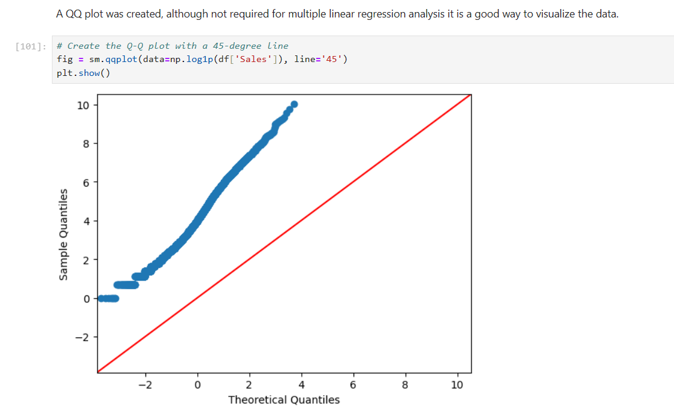
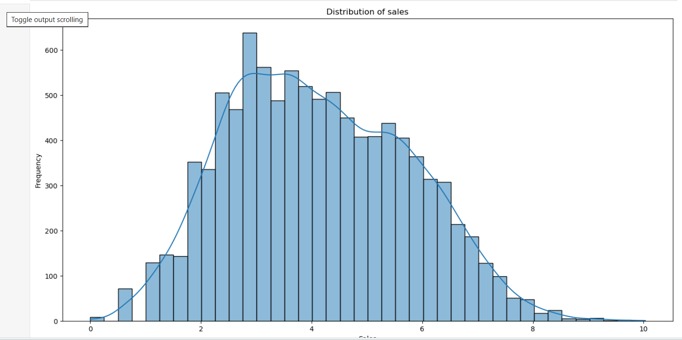
Project analysis slide 5
Visualizing Data

Slide 10
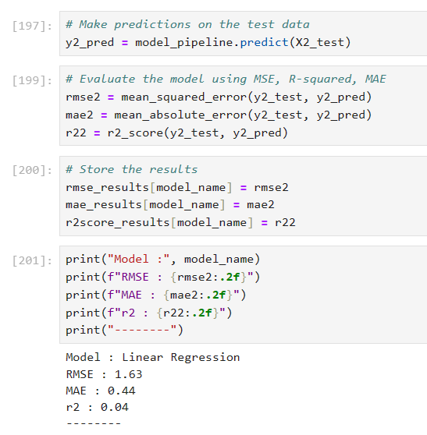
Project analysis slide 10
Multiple Linear Regression
RMSE stands for root mean squared error is 1.63. The closer to zero the rmse score is the more accurate the prediction is
MAE stands for mean absolute error is .44. The closer the mae is to zero the more accurate the models' prediction.
R-squared is 0.04. The closer to 1 the r squared value is the better fit the regression is.

Slide 11
Project analysis slide 8
Limitations and Benefits
Benefit
Limitation
The multiple linear regression analysis uses historic sales data to find patterns between the independent and dependent variables to predict future sales.
The lack of review data from consumers
Predicting future sales revenue and the variables that have the most statistically significant impact on the sales revenue provides actionable insights for smart business decisions.
A delimitation would be the automatic removal of several columns prior to analysis due to the lack of statistical significance

Slide 12

Thank You!
Recommendations:
>Perform market basket analysis or another classification model
>Perform a time series analysis
>Collect review data from the superstore customers
Student id 008756001

